Slide 1
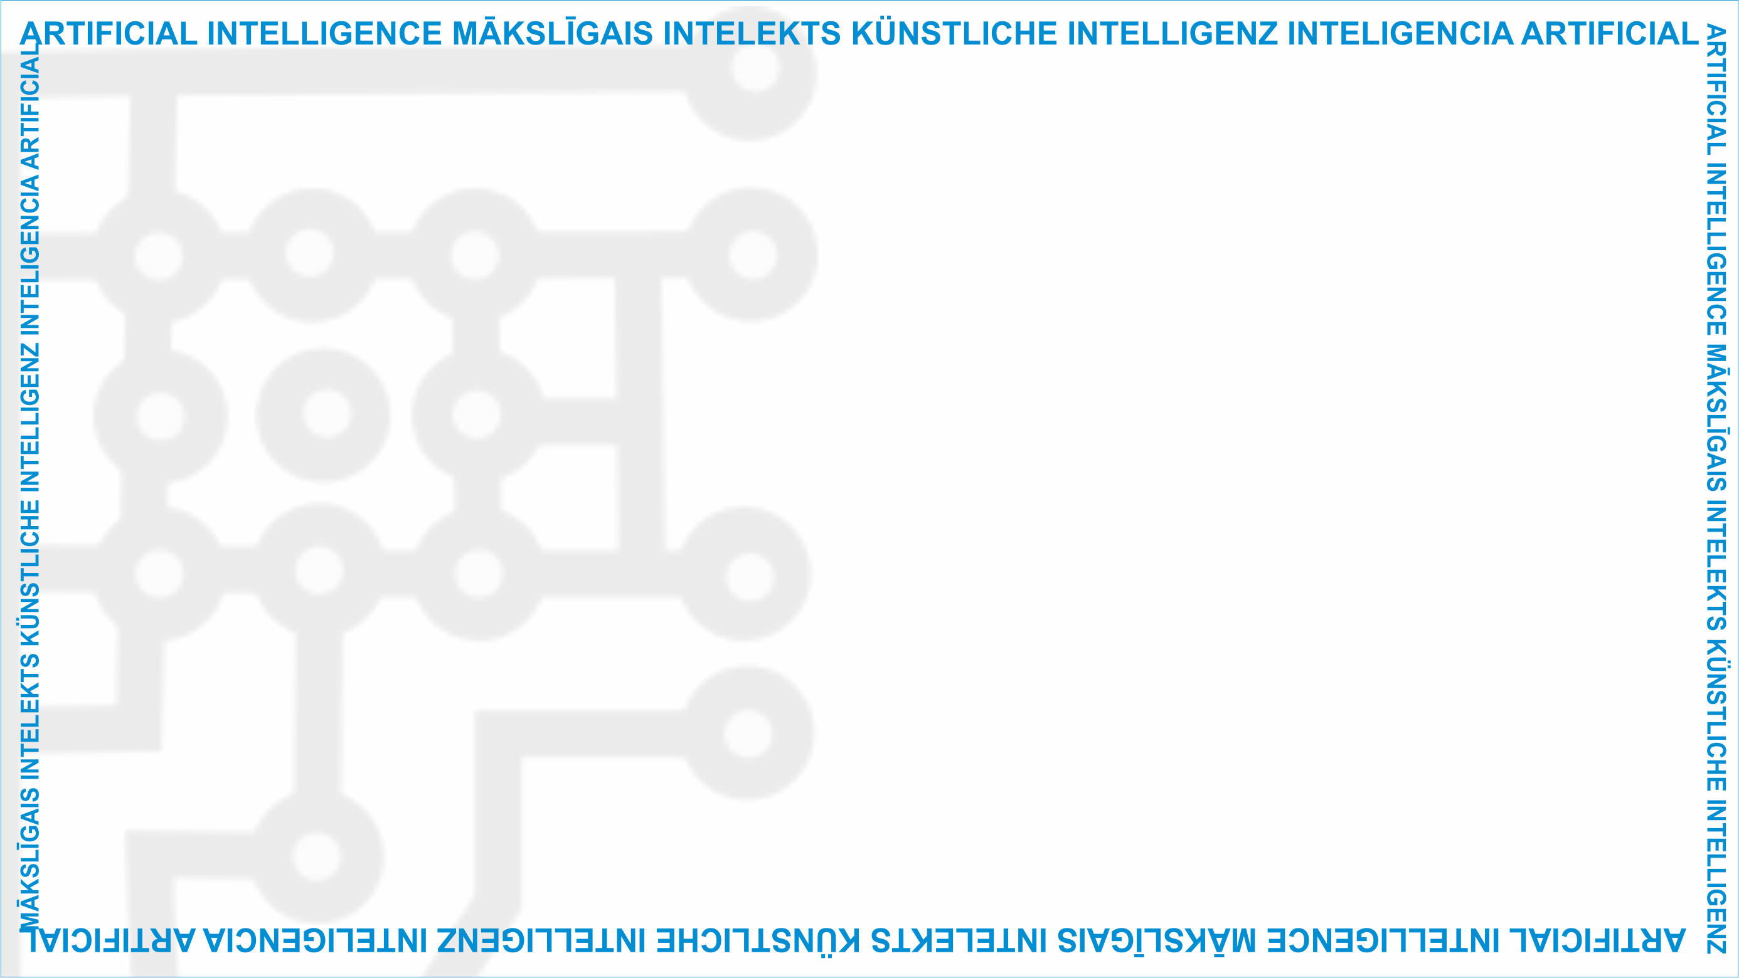
ArtIn Future – Ethics in Artificial Intelligence
Module: What impact does AI have?
Unit: Ethical skills and attitudes to prepare humans for living and working with AI technologies
Five-point ethical guideline for beneficial AI
Target learners: 9th-grade learners (14-15 years old)
Developed by:
BEST Institut für berufsbezogene Weiterbildung und Personaltraining GmbH

Slide 2
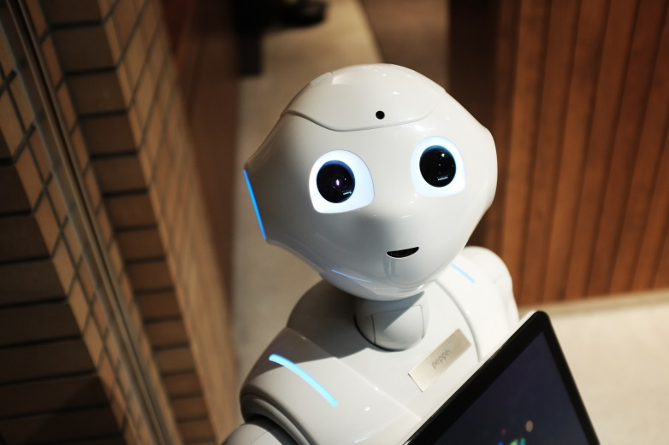
Warm-up exercise
Question: How would you define ethical AI?
Unit Lesson
3.3 Ethical skills and attitudes to prepare humans for living and working with AI technologies
Source: https://www.pexels.com/photo/high-angle-photo-of-robot-2599244/
This project has been funded with support from the European Commission under the Erasmus+ Programme.
This publication only reflects the views of the author, and the Commission cannot be held responsible for any
use which may be made of the information contained therein. (2020-1-DE02-KA226-VET-00813)

Slide 3
5 principles for ethical AI
Human flourishing should be a foundation of ethical AI. That’s why every AI should:
be good for humankind and sustainable for the planet.
protect our rights.
let us decide on our own.
keep our societies happy and fair.
be easy to understand and transparent.
3.3 Ethical skills and attitudes to prepare humans for living and working with AI technologies
This project has been funded with support from the European Commission under the Erasmus+ Programme.
This publication only reflects the views of the author, and the Commission cannot be held responsible for any
use which may be made of the information contained therein. (2020-1-DE02-KA226-VET-00813)

Slide 4
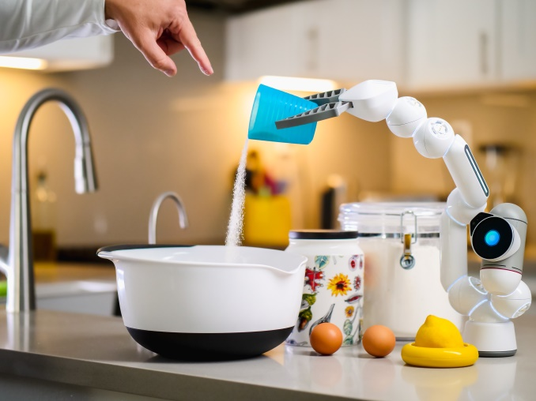
Let‘s see if AI passes our moral test!
3.3 Ethical skills and attitudes to prepare humans for living and working with AI technologies
Source: https://www.pexels.com/photo/dawn-man-woman-coffee-9028872/
This project has been funded with support from the European Commission under the Erasmus+ Programme.
This publication only reflects the views of the author, and the Commission cannot be held responsible for any
use which may be made of the information contained therein. (2020-1-DE02-KA226-VET-00813)

Slide 5
Group activity
Create teams and see if any of the following AI examples pass the test:
Smart assistants
Navigation apps
Facial-recognition systems
3.3 Ethical skills and attitudes to prepare humans for living and working with AI technologies
This project has been funded with support from the European Commission under the Erasmus+ Programme.
This publication only reflects the views of the author, and the Commission cannot be held responsible for any
use which may be made of the information contained therein. (2020-1-DE02-KA226-VET-00813)

Slide 6
What is a smart assistant?
A software installed in a smart device which can perform certain tasks, provide services, or answer questions.
Amazon‘s Alexa, Windows‘ Cortana, or iPhone‘s Siri are the best-known examples.
3.3 Ethical skills and attitudes to prepare humans for living and working with AI technologies
Source: https://www.pexels.com/photo/wood-dawn-coffee-dark-4790268/
This project has been funded with support from the European Commission under the Erasmus+ Programme.
This publication only reflects the views of the author, and the Commission cannot be held responsible for any
use which may be made of the information contained therein. (2020-1-DE02-KA226-VET-00813)

Slide 7
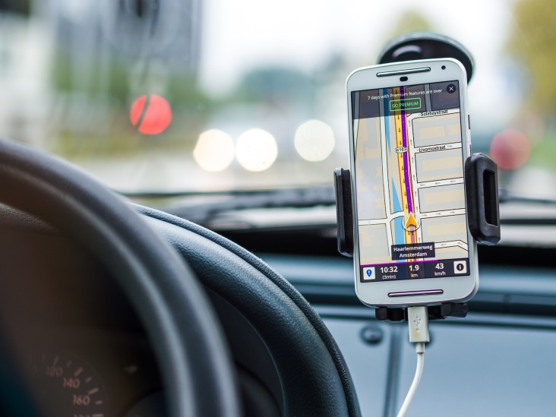
What is a navigation app?
AI-powered mobile or device applications which can take a person from point A to point B in real time. For example: Google Maps.
3.3 Ethical skills and attitudes to prepare humans for living and working with AI technologies
Source: https://www.pexels.com/photo/smartphone-car-technology-phone-33488/
This project has been funded with support from the European Commission under the Erasmus+ Programme.
This publication only reflects the views of the author, and the Commission cannot be held responsible for any
use which may be made of the information contained therein. (2020-1-DE02-KA226-VET-00813)

Slide 8
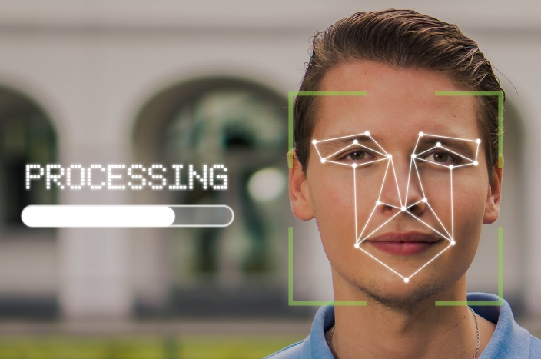
What is a facial-recognition system?
Software which can quickly search through databases of faces and compare them to a face detected in an image or a video.
3.3 Ethical skills and attitudes to prepare humans for living and working with AI technologies
Source: https://pixabay.com/de/photos/mann-gesicht-gesichtserkennung-5946820/
This project has been funded with support from the European Commission under the Erasmus+ Programme.
This publication only reflects the views of the author, and the Commission cannot be held responsible for any
use which may be made of the information contained therein. (2020-1-DE02-KA226-VET-00813)

Slide 9
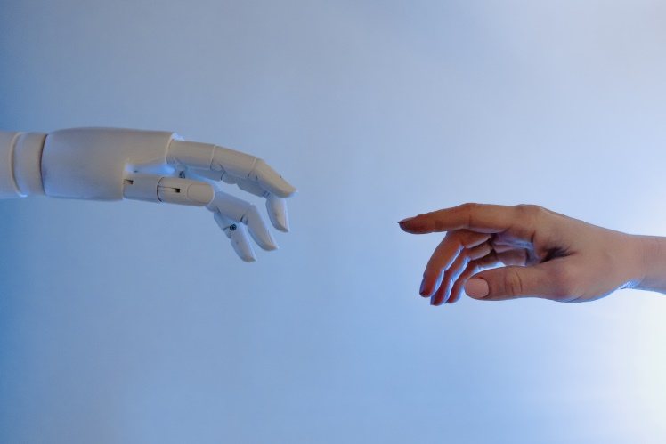
Questions or comments?
3.3 Ethical skills and attitudes to prepare humans for living and working with AI technologies
Source: https://www.pexels.com/photo/person-reaching-out-to-a-robot-8386434/
This project has been funded with support from the European Commission under the Erasmus+ Programme.
This publication only reflects the views of the author, and the Commission cannot be held responsible for any
use which may be made of the information contained therein. (2020-1-DE02-KA226-VET-00813)

Slide 10
Food for thought
How much did you learn from this lesson?
Do you think we are on our way to creating more ethical AI?
Have your ethical attitudes towards AI changed after this lesson?
3.3 Ethical skills and attitudes to prepare humans for living and working with AI technologies
This project has been funded with support from the European Commission under the Erasmus+ Programme.
This publication only reflects the views of the author, and the Commission cannot be held responsible for any
use which may be made of the information contained therein. (2020-1-DE02-KA226-VET-00813)

Slide 11
Further reading
To show you what experts say about AI ethics:
Five principles for morally good AI: https://hdsr.mitpress.mit.edu/pub/l0jsh9d1/release/7
EU guidelines for trustworthy AI: https://digital-strategy.ec.europa.eu/en/library/ethics-guidelines-trustworthy-ai
The IEEE’s ethical standards for AI: https://standards.ieee.org/content/dam/ieee-standards/standards/web/documents/other/ead1e_general_principles.pdf?utm_medium=undefined&utm_source=undefined&utm_campaign=undefined&utm_content=undefined&utm_term=undefined
3.3 Ethical skills and attitudes to prepare humans for living and working with AI technologies
This project has been funded with support from the European Commission under the Erasmus+ Programme.
This publication only reflects the views of the author, and the Commission cannot be held responsible for any
use which may be made of the information contained therein. (2020-1-DE02-KA226-VET-00813)

Slide 12
Project website: www.ai-future-project.eu
Facebook page: facebook.com/artin-future

