Slide 1
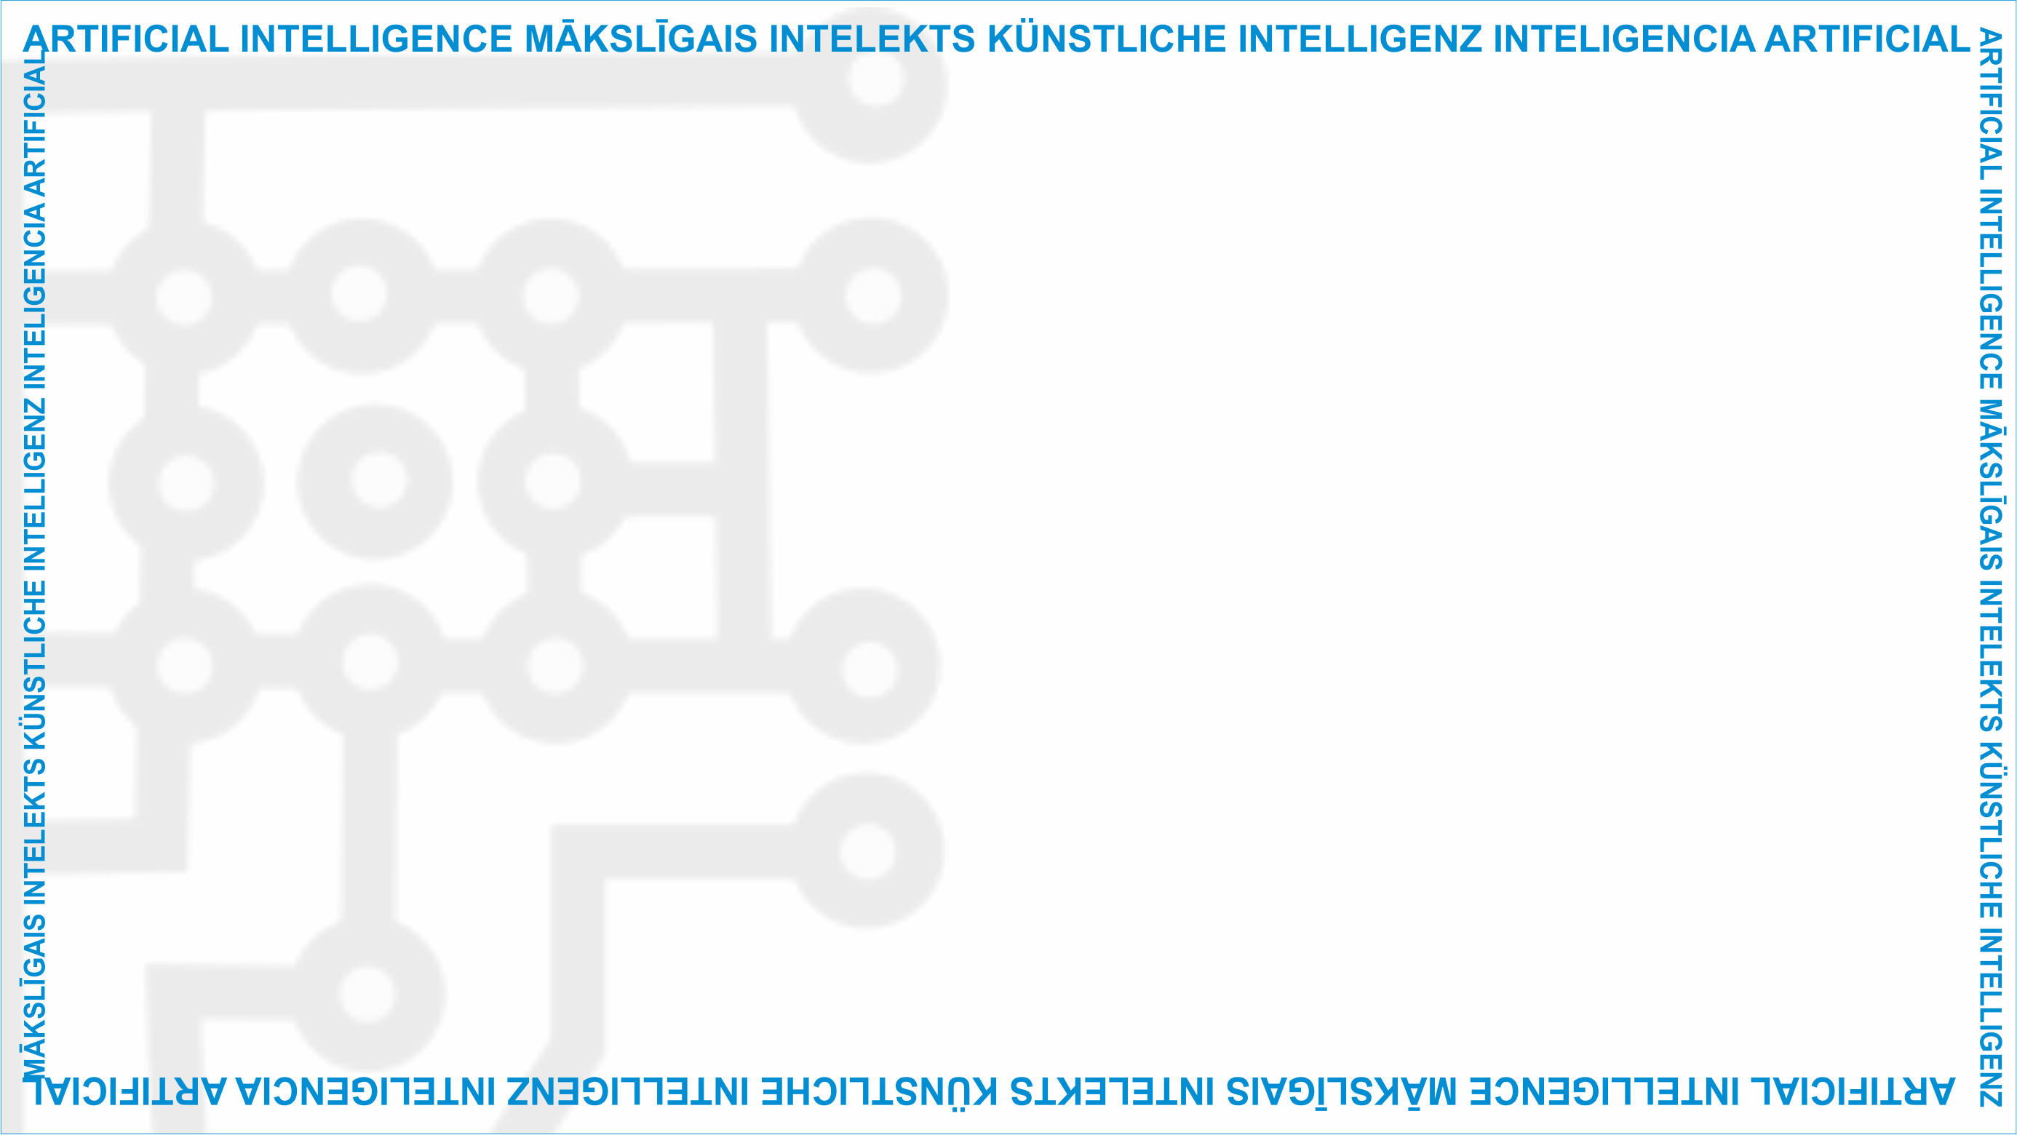
ArtIn Future – Ethics in Artificial Intelligence
Module: What does AI do? The potential and risks of AI from an ethical point of view
Unit: A case study of AI potential and risks
Analysis of AI of your choice
Target learners: 9th-grade learners (14-15 years old)
Developed by:
BEST Institut für berufsbezogene Weiterbildung und Personaltraining GmbH

Slide 2
Individual task
Now that we’ve covered the theoretical AI benefits and risks, you should be able to apply that knowledge in practice.
Unit Lesson
2.3 A case study of AI potential and risks
This project has been funded with support from the European Commission under the Erasmus+ Programme.
This publication only reflects the views of the author, and the Commission cannot be held responsible for any
use which may be made of the information contained therein. (2020-1-DE02-KA226-VET-00813)

Slide 3
Choose an AI technology you’d like to analyse. Your case study should include both AI potential and risks from economic, technical, and social perspectives.
Unit Lesson
2.3 A case study of AI potential and risks
This project has been funded with support from the European Commission under the Erasmus+ Programme.
This publication only reflects the views of the author, and the Commission cannot be held responsible for any
use which may be made of the information contained therein. (2020-1-DE02-KA226-VET-00813)

Slide 4
You have 1 hour and 20 minutes to complete your task. Good luck!
Unit Lesson
2.3 A case study of AI potential and risks
Source: https://www.pexels.com/photo/green-leaves-on-black-soil-4077180/
This project has been funded with support from the European Commission under the Erasmus+ Programme.
This publication only reflects the views of the author, and the Commission cannot be held responsible for any
use which may be made of the information contained therein. (2020-1-DE02-KA226-VET-00813)

Slide 5
Project website: www.ai-future-project.eu
Facebook page: facebook.com/artin-future

