Slide 1
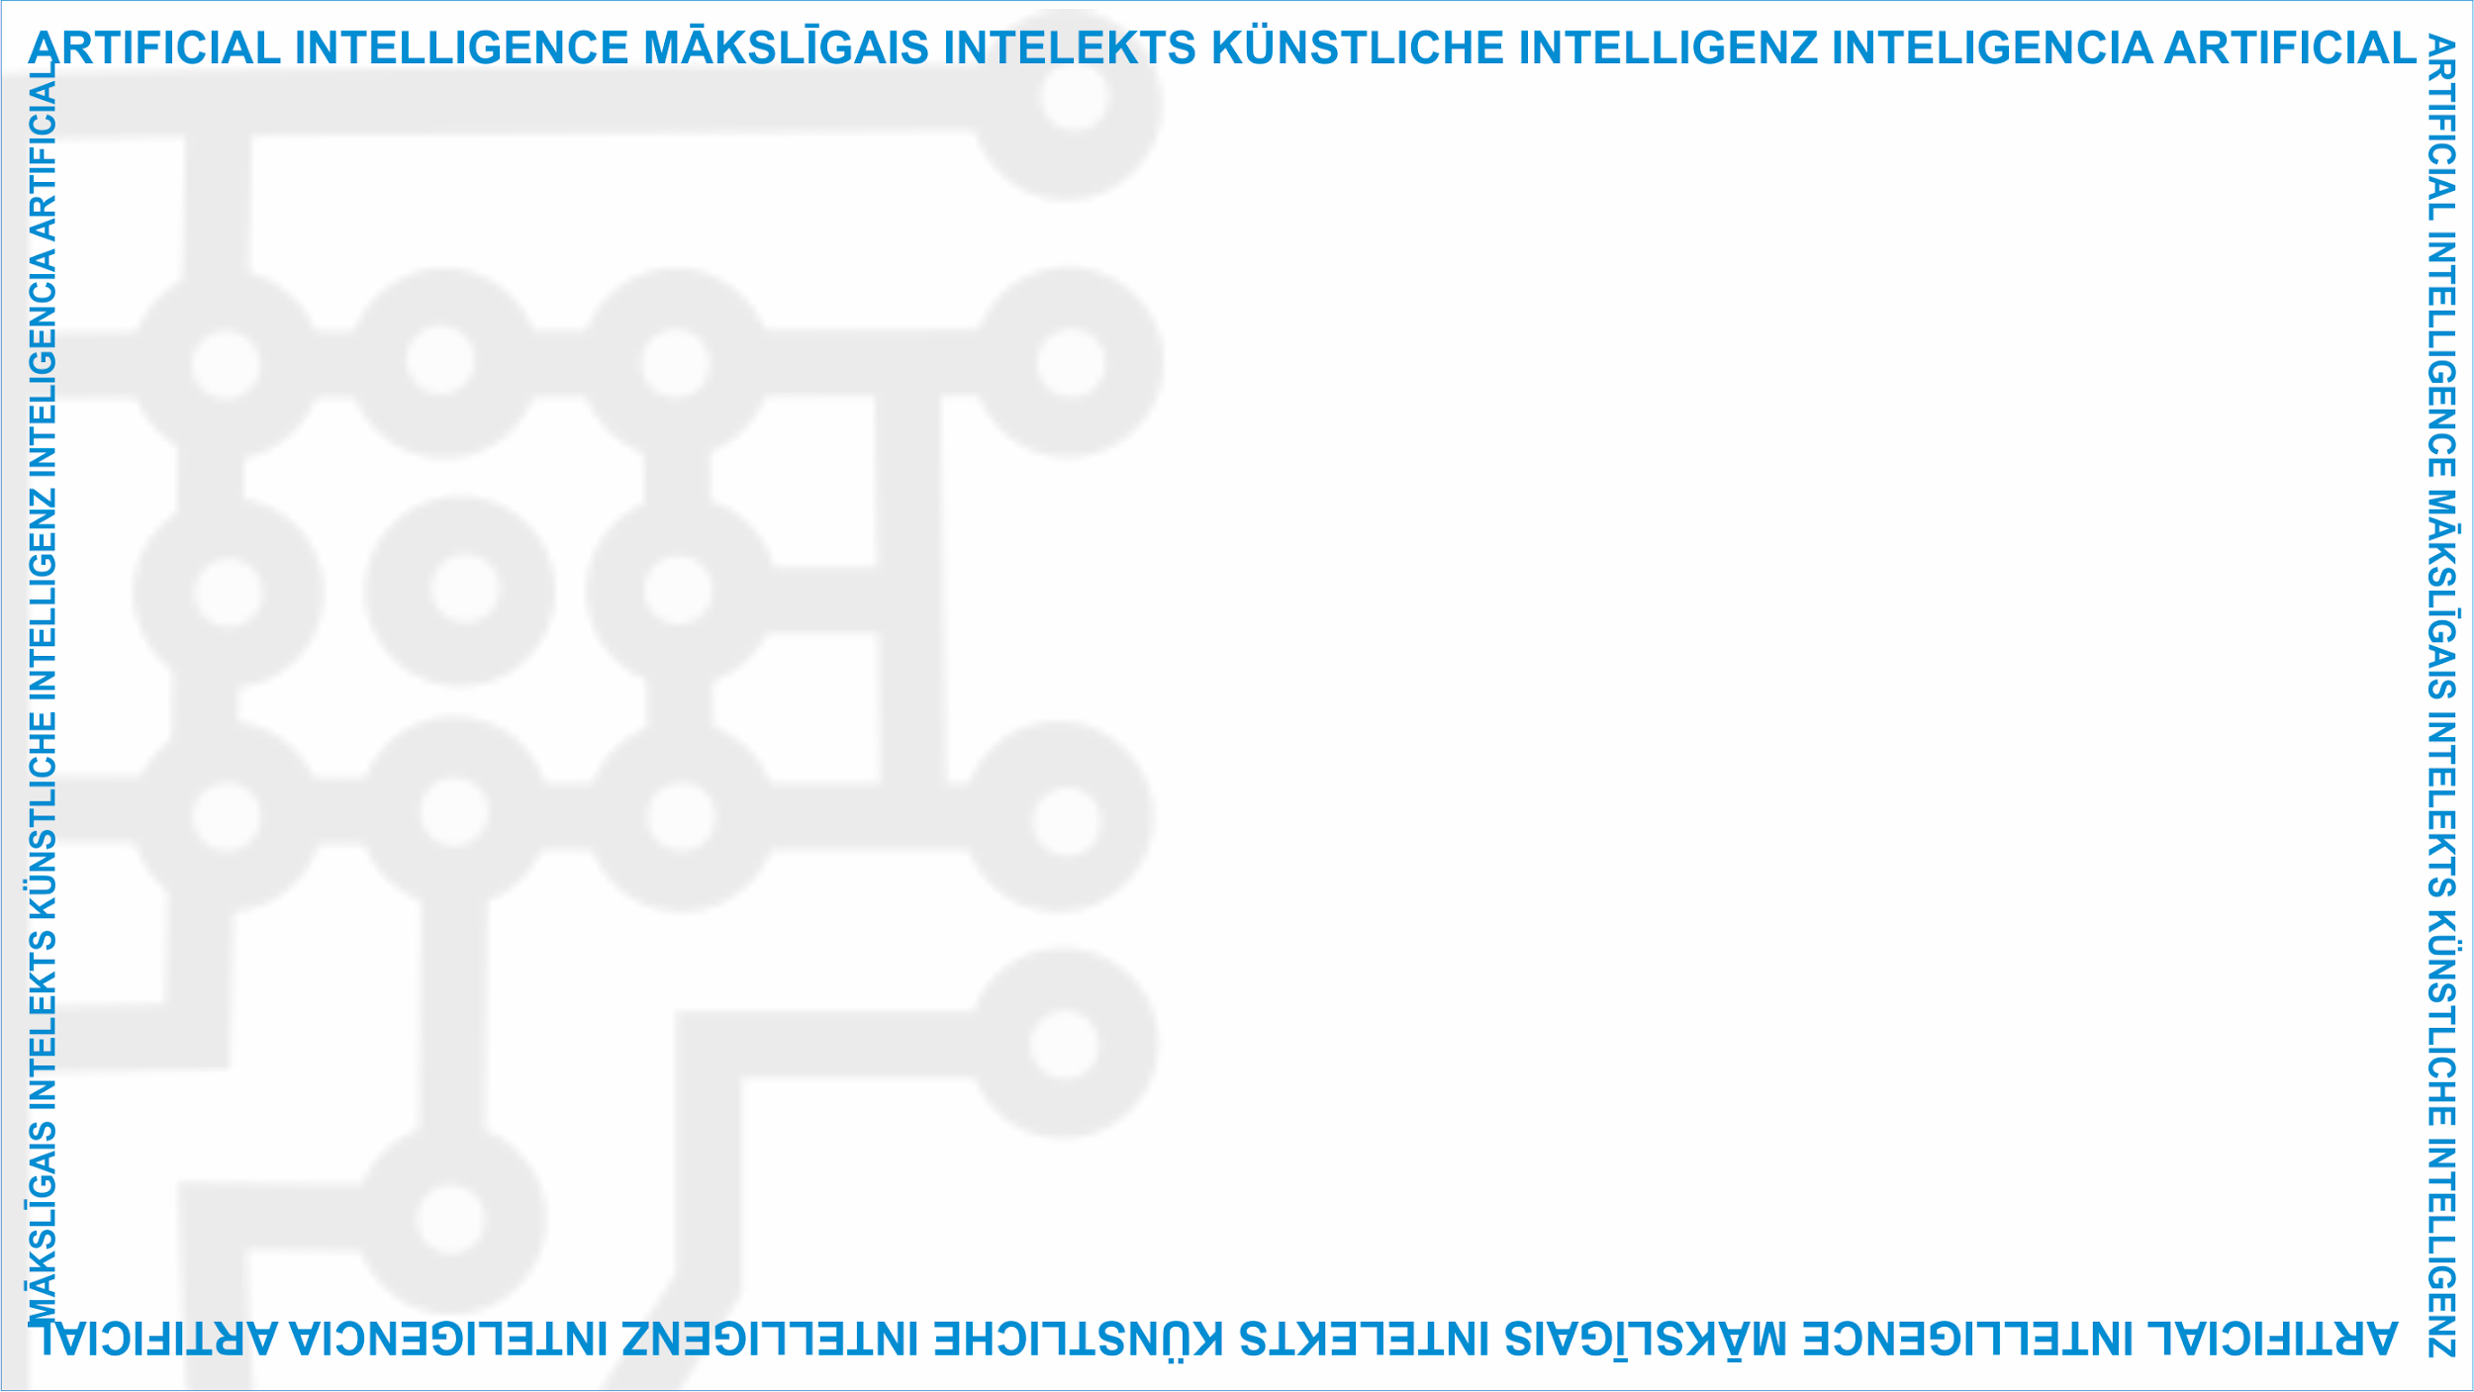
ArtIn Future – Ethics in Artificial Intelligence
Module: What does AI do?
Unit: AI Risks
Negative impact of AI
Target learners: 9th-grade learners (14-15 years old)
Developed by:
BEST Institut für berufsbezogene Weiterbildung und Personaltraining GmbH

Slide 2
AI risks
There are some general issues with AI, despite its overall positive impact.
Economic risks: AI can lead to unemployment and job loss.
Technical risks: AI is still unsafe and may cause us harm.
Social risks: AI can violate our rights and discriminate against us.
Unit Lesson
2.2 AI risks
This project has been funded with support from the European Commission under the Erasmus+ Programme.
This publication only reflects the views of the author, and the Commission cannot be held responsible for any
use which may be made of the information contained therein. (2020-1-DE02-KA226-VET-00813)

Slide 3
Economic AI risks
Many fear that AI will replace workers or cause entire jobs to disappear.
As AI continues to improve, there is a fear it will be able to do predictive and routine tasks more quickly and efficiently than humans.
A Bruegel think-tank forecasted that AI could ‘take over’ about 50 percent of such jobs and replace humans in these workplaces.
2.2 AI risks
This project has been funded with support from the European Commission under the Erasmus+ Programme.
This publication only reflects the views of the author, and the Commission cannot be held responsible for any
use which may be made of the information contained therein. (2020-1-DE02-KA226-VET-00813)

Slide 4
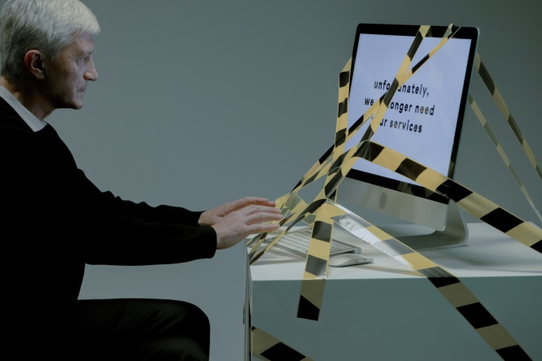
Economic AI risks
For example, people working in customer service, transportation, manufacturing or agriculture could lose their jobs to robots and machines.
2.2 AI risks
Source: https://www.pexels.com/photo/man-typing-on-computer-which-is-tied-with-a-tape-9830809/
This project has been funded with support from the European Commission under the Erasmus+ Programme.
This publication only reflects the views of the author, and the Commission cannot be held responsible for any
use which may be made of the information contained therein. (2020-1-DE02-KA226-VET-00813)

Slide 5
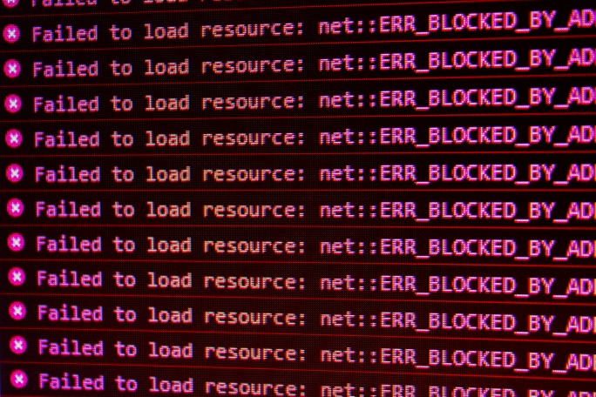
Technical AI risks
Even though AI has the potential to automatically perform certain tasks, it could also physically harm us.
2.2 AI risks
Source: https://unsplash.com/photos/heNwUmEtZzo
This project has been funded with support from the European Commission under the Erasmus+ Programme.
This publication only reflects the views of the author, and the Commission cannot be held responsible for any
use which may be made of the information contained therein. (2020-1-DE02-KA226-VET-00813)

Slide 6
Technical AI risks
According to the AI incidents database, an Uber self-driving car killed a person in 2018. The system which should have made the car to stop in case of an emergency had been disabled and unfortunately killed a woman.
Robots sparked a fire in a warehouse of the British online grocery store Ocado and the London Fire Brigade had to put it out.
2.2 AI risks
This project has been funded with support from the European Commission under the Erasmus+ Programme.
This publication only reflects the views of the author, and the Commission cannot be held responsible for any
use which may be made of the information contained therein. (2020-1-DE02-KA226-VET-00813)

Slide 7
Social AI risks
Just as AI can physically hurt us, AI can also harm us by violating our rights.
For example, in a hospital in the US, an algorithm denied healthcare to African-American patients. These patients, who urgently needed a kidney transplant, were overlooked by the hospital’s AI.
The Chinese government developed a national ‘social credit system’. This system judges their citizens’ behaviour and if they do something ‘wrong’, like playing loud music on the train, they are banned from booking a train ticket.
2.2 AI risks
This project has been funded with support from the European Commission under the Erasmus+ Programme.
This publication only reflects the views of the author, and the Commission cannot be held responsible for any
use which may be made of the information contained therein. (2020-1-DE02-KA226-VET-00813)

Slide 8
Social AI risks
There are many cases of AI discriminating people based on their race or gender.
In the US, the police arrested an African-American man because a facial recognition system falsely identified him as a criminal.
Some examples are also still based on stereotypes: When searching for images of doctors, Google Image usually shows pictures of male doctors. When searching for pictures of nurses, in most cases women are shown as nurses.
2.2 AI risks
This project has been funded with support from the European Commission under the Erasmus+ Programme.
This publication only reflects the views of the author, and the Commission cannot be held responsible for any
use which may be made of the information contained therein. (2020-1-DE02-KA226-VET-00813)

Slide 9
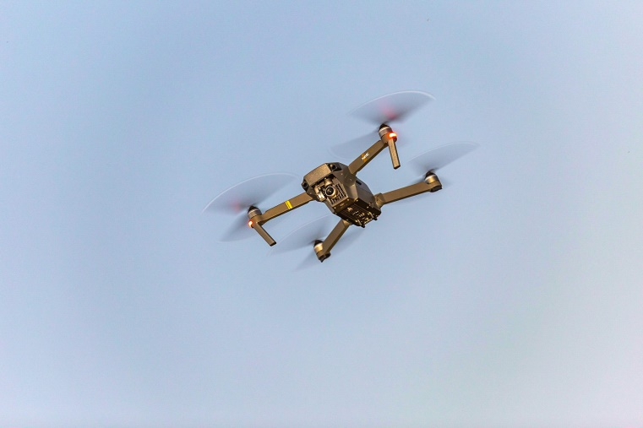
Social AI risks
As we start to rely on AI in every aspect of our lives, it will soon find its way into warfare too.
AI-powered weapons could quickly become a reality, and instead of armies, they could lead wars and take human lives.
2.2 AI risks
Source: https://www.pexels.com/photo/flying-drone-1757697/
This project has been funded with support from the European Commission under the Erasmus+ Programme.
This publication only reflects the views of the author, and the Commission cannot be held responsible for any
use which may be made of the information contained therein. (2020-1-DE02-KA226-VET-00813)

Slide 10
Group activity – debate
Now that we’ve learnt about positive and negative ethical AI aspects, let’s debate if AI is morally good or bad.
The first team will argue that it’s morally good.
The second team will say it’s morally bad.
The judging team will listen closely to what both teams say and decide who will win the debate.
2.2 AI risks
This project has been funded with support from the European Commission under the Erasmus+ Programme.
This publication only reflects the views of the author, and the Commission cannot be held responsible for any
use which may be made of the information contained therein. (2020-1-DE02-KA226-VET-00813)

Slide 11
Rules of the debate
The chairperson of the judging team will introduce today’s topic.
After the introduction, the learners who’ll speak first will make opening speeches. Each will be given 3 minutes to present their opening remark.
After that, the learners have the opportunity to pose questions to the opposing team or respond to their remarks.
When scoring the debate, the judging team should bear the following in mind:
Do learners have clear knowledge of the topic?
Are their arguments well structured?
How do the participants think under pressure?
Can they respond to different lines of argument?
2.2 AI risks
This project has been funded with support from the European Commission under the Erasmus+ Programme.
This publication only reflects the views of the author, and the Commission cannot be held responsible for any
use which may be made of the information contained therein. (2020-1-DE02-KA226-VET-00813)

Slide 12
Judging team’s scores
Please share with us how you decided who will be the winning team of the debate!
2.2 AI risks
Source: https://www.pexels.com/photo/people-holding-trophies-6250930/
This project has been funded with support from the European Commission under the Erasmus+ Programme.
This publication only reflects the views of the author, and the Commission cannot be held responsible for any
use which may be made of the information contained therein. (2020-1-DE02-KA226-VET-00813)

Slide 13
Project website: www.ai-future-project.eu
Facebook page: facebook.com/artin-future

