Slide 1
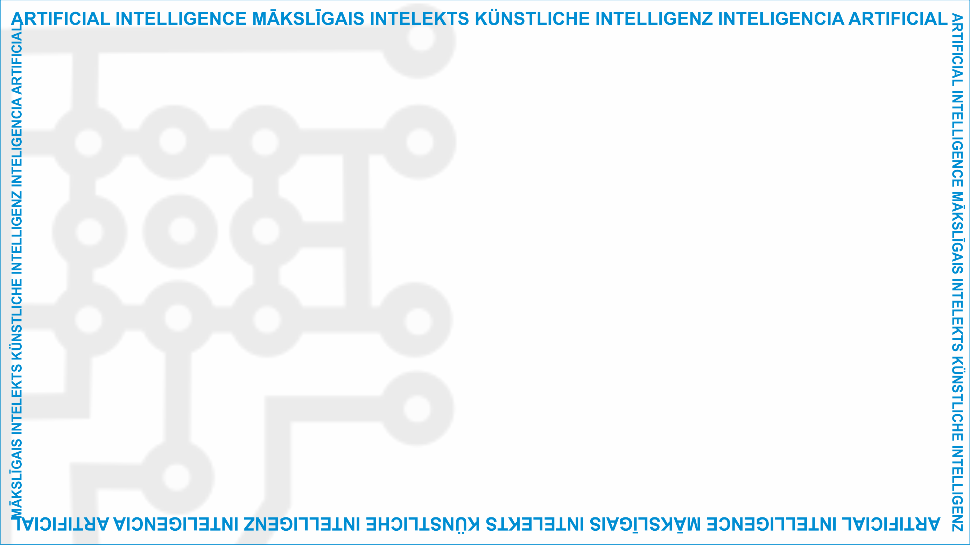
ArtIn Future – Ethics in Artificial Intelligence
Module: What does AI do?
Unit: The potential of AI
Positive impact of AI
Target learners: 9th-grade learners (14-15 years old)
Developed by:
BEST Institut für berufsbezogene Weiterbildung und Personaltraining GmbH

Slide 2
The potential of AI
Overall, AI can allow humans to flourish and improve their lives and well-being.
Economic benefits: AI can increase global wealth.
Technical benefits: AI won’t just help people live their lives more efficiently and free them from repetitive tasks, but it can also perform tasks no human intelligence could do.
Social benefits: AI can improve our well-being and enable individuals to fully enjoy their rights and freedoms.
Unit Lesson
2.1 The potential of AI
This project has been funded with support from the European Commission under the Erasmus+ Programme.
This publication only reflects the views of the author, and the Commission cannot be held responsible for any
use which may be made of the information contained therein. (2020-1-DE02-KA226-VET-00813)

Slide 3
Economic potential of AI
Using AI technologies will benefit companies. A study by PwC shows that AI will result in all sectors of economy increasing their profits by at least 10 percent.
2.1 The potential of AI
Source: https://pixabay.com/de/illustrations/profite-einnahmen-gesch%c3%a4ft-1953616/
This project has been funded with support from the European Commission under the Erasmus+ Programme.
This publication only reflects the views of the author, and the Commission cannot be held responsible for any
use which may be made of the information contained therein. (2020-1-DE02-KA226-VET-00813)

Slide 4
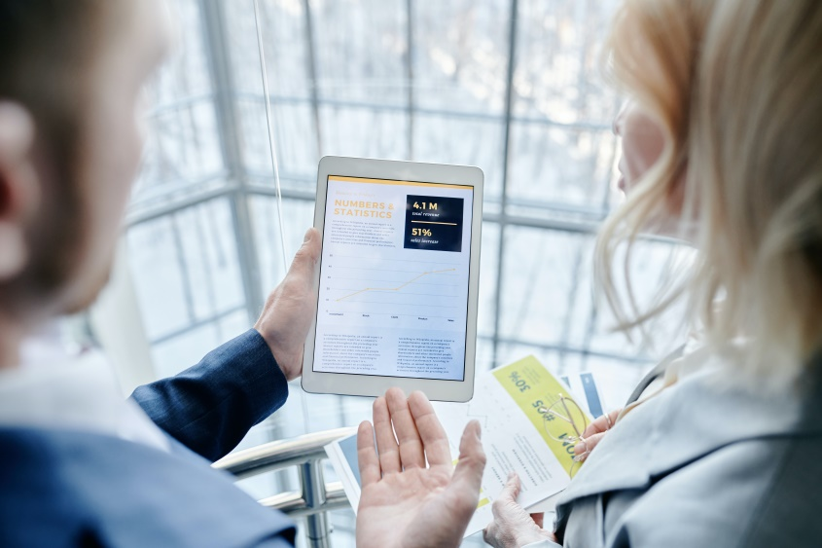
Economic potential of AI
The sectors which would benefit the most are retail, wholesale trade, accommodation, and food services. They are expected to have a 15 percent increase in profits.
2.1 The potential of AI
Source: https://www.pexels.com/photo/a-person-showing-a-woman-his-tablet-7109176/
This project has been funded with support from the European Commission under the Erasmus+ Programme.
This publication only reflects the views of the author, and the Commission cannot be held responsible for any
use which may be made of the information contained therein. (2020-1-DE02-KA226-VET-00813)

Slide 5
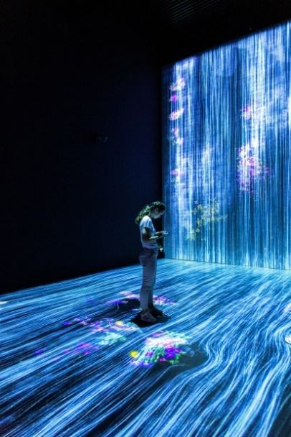
Technical potential of AI
AI is capable of analysing large amounts of data and discovering patterns among these pieces of information.
AI technologies could help us push boundaries of our own knowledge and skills.
2.1 The potential of AI
Source: https://unsplash.com/photos/hJ5uMIRNg5k
This project has been funded with support from the European Commission under the Erasmus+ Programme.
This publication only reflects the views of the author, and the Commission cannot be held responsible for any
use which may be made of the information contained therein. (2020-1-DE02-KA226-VET-00813)

Slide 6
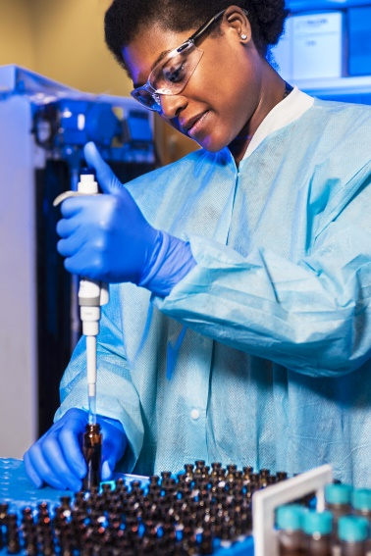
Technical potential of AI
For example, AI in healthcare can help doctors with detecting diseases and curing them and assist them in performing complex operations too.
AI could potentially extend human life expectancy.
2.1 The potential of AI
Source: https://unsplash.com/photos/_N7I1JyPYJw
This project has been funded with support from the European Commission under the Erasmus+ Programme.
This publication only reflects the views of the author, and the Commission cannot be held responsible for any
use which may be made of the information contained therein. (2020-1-DE02-KA226-VET-00813)

Slide 7
Social potential of AI
AI could have a positive effect on our well-being too.
For example, instead of waiting on the phone to schedule a doctor’s appointment, a chatbot, which is accessible 24/7, would allow patients to quickly book their visit to the doctor and avoid the stress of a busy line.
2.1 The potential of AI
Source: https://www.pexels.com/photo/unrecognizable-happy-people-jumping-in-sunset-6152103/
This project has been funded with support from the European Commission under the Erasmus+ Programme.
This publication only reflects the views of the author, and the Commission cannot be held responsible for any
use which may be made of the information contained therein. (2020-1-DE02-KA226-VET-00813)

Slide 8
Social potential of AI
Staff working in a doctor’s practice can also benefit from this. With AI on their side, they would be productive, efficient, and less stressed at work.
2.1 The potential of AI
Source: https://www.pexels.com/photo/two-women-with-headsets-working-as-call-center-agents-8867382/
This project has been funded with support from the European Commission under the Erasmus+ Programme.
This publication only reflects the views of the author, and the Commission cannot be held responsible for any
use which may be made of the information contained therein. (2020-1-DE02-KA226-VET-00813)

Slide 9
Potential of AI
Have you had a positive experience with AI?
Could you share the story with your classmates?
2.1 The potential of AI
Source: https://www.pexels.com/photo/woman-sharing-her-presentation-with-her-colleagues-3153198/
This project has been funded with support from the European Commission under the Erasmus+ Programme.
This publication only reflects the views of the author, and the Commission cannot be held responsible for any
use which may be made of the information contained therein. (2020-1-DE02-KA226-VET-00813)

Slide 10
Individual task
Let’s continue learning about the potential of AI. Choose an AI-powered technology and research how it uses artificial intelligence to improve our lives.
2.1 The potential of AI
Source: https://www.pexels.com/photo/woman-touching-a-black-miniature-robot-toy-8566453/
This project has been funded with support from the European Commission under the Erasmus+ Programme.
This publication only reflects the views of the author, and the Commission cannot be held responsible for any
use which may be made of the information contained therein. (2020-1-DE02-KA226-VET-00813)

Slide 11
Individual task
Point out any ethical benefits of that particular AI.
For example: Crosswalks are different all around the world. They use a zebra pattern to mark the crosswalk in the US. A dotted line in Great Britain. Data scientists at Google are training AI in Google Maps to recognise different types of crosswalks and show pedestrians the exact routes they should take to reach their destination.
Can AI make sure we are safe all around the world?
More details here: https://blog.google/products/maps/google-maps-101-ai-power-new-features-io-2021/
2.1 The potential of AI
This project has been funded with support from the European Commission under the Erasmus+ Programme.
This publication only reflects the views of the author, and the Commission cannot be held responsible for any
use which may be made of the information contained therein. (2020-1-DE02-KA226-VET-00813)

Slide 12
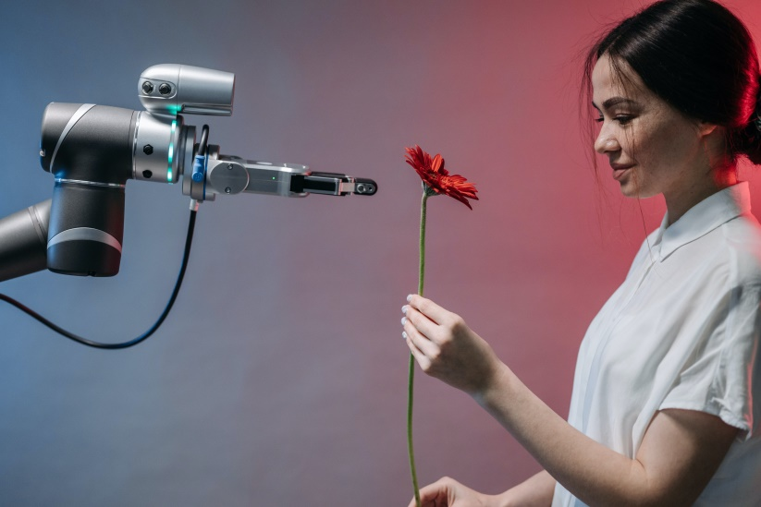
Questions or comments?
2.1 The potential of AI
Source: https://www.pexels.com/photo/man-people-woman-girl-8438969/
This project has been funded with support from the European Commission under the Erasmus+ Programme.
This publication only reflects the views of the author, and the Commission cannot be held responsible for any
use which may be made of the information contained therein. (2020-1-DE02-KA226-VET-00813)

Slide 13
Food for thought
Did your perception of AI change? If so, in what way?
How would you assess the potential of AI? Do you think it will dramatically change the world or only slightly improve it?
2.1 The potential of AI
This project has been funded with support from the European Commission under the Erasmus+ Programme.
This publication only reflects the views of the author, and the Commission cannot be held responsible for any
use which may be made of the information contained therein. (2020-1-DE02-KA226-VET-00813)

Slide 14
Further reading
To give you more information about the benefits of AI:
How to benefit from AI: https://www.iotforall.com/8-helpful-everyday-examples-of-artificial-intelligence
Benefits of AI on the economy and society: https://hackr.io/blog/benefits-of-artificial-intelligence
7 benefits of AI: https://interestingengineering.com/7-ways-ai-will-help-humanity-not-harm-it
To get a bigger picture about the benefits and risks of AI:
The Brookings Institution’s article on how AI transforms the world: https://www.brookings.edu/research/how-artificial-intelligence-is-transforming-the-world/
2.1 The potential of AI
This project has been funded with support from the European Commission under the Erasmus+ Programme.
This publication only reflects the views of the author, and the Commission cannot be held responsible for any
use which may be made of the information contained therein. (2020-1-DE02-KA226-VET-00813)

Slide 15
Project website: www.ai-future-project.eu
Facebook page: facebook.com/artin-future

