Slide 1
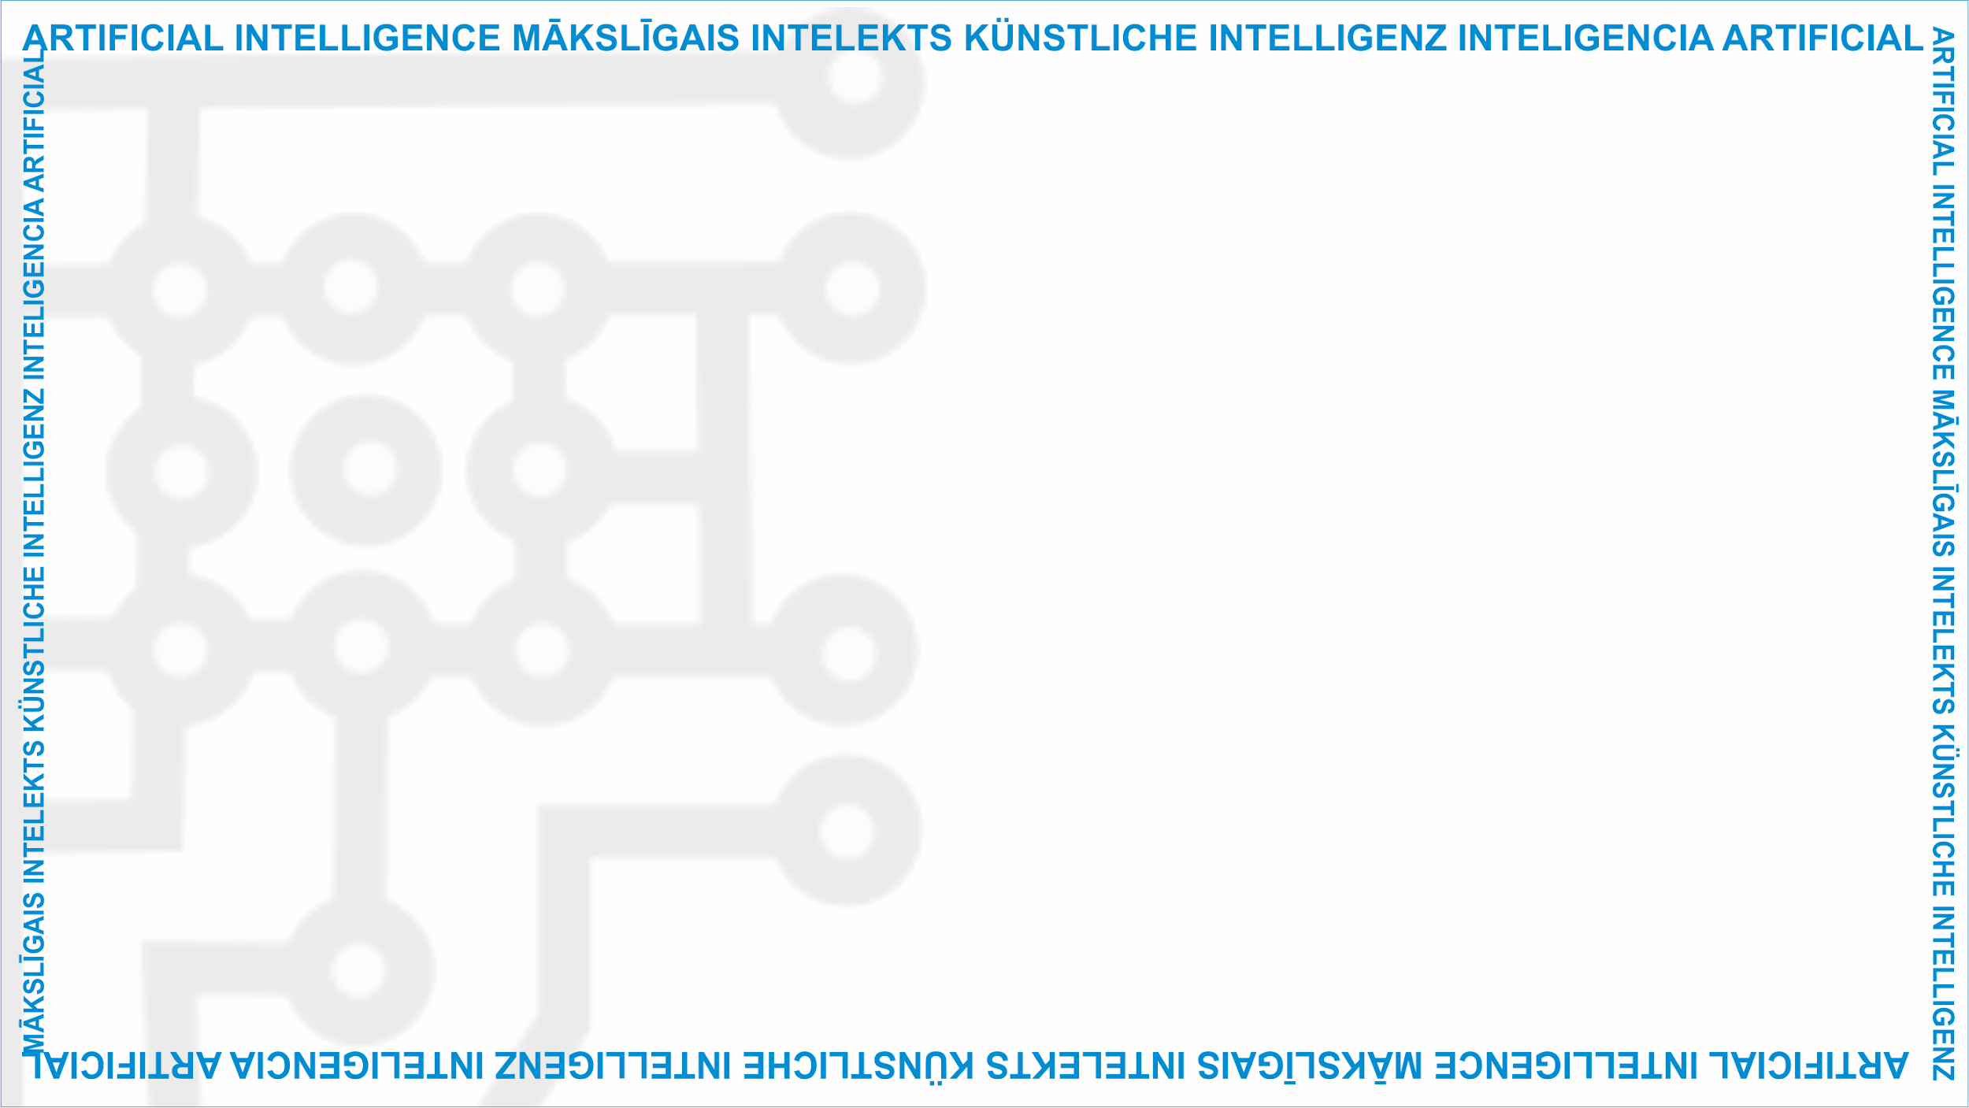
ArtIn Future – Ethics in Artificial Intelligence
Module: What is AI?
Unit: Ethical principles and their relevance to ICT and AI
Introduction to AI ethics
Target learners: 9th-grade learners (14-15 years old)
Developed by:
BEST Institut für berufsbezogene Weiterbildung und Personaltraining GmbH

Slide 2
What is ethics?
Ethics is a discipline which studies what’s ‘right’ and ‘wrong’.
It questions whether our thoughts and actions are morally good and benefit others or morally bad and harm people around us.
Unit Lesson
1.3 Ethical principles and their relevance to ICT and AI
Source: https://pixabay.com/de/photos/ethik-rechts-falsch-ethisch-moral-2991600/
This project has been funded with support from the European Commission under the Erasmus+ Programme.
This publication only reflects the views of the author, and the Commission cannot be held responsible for any
use which may be made of the information contained therein. (2020-1-DE02-KA226-VET-00813)

Slide 3
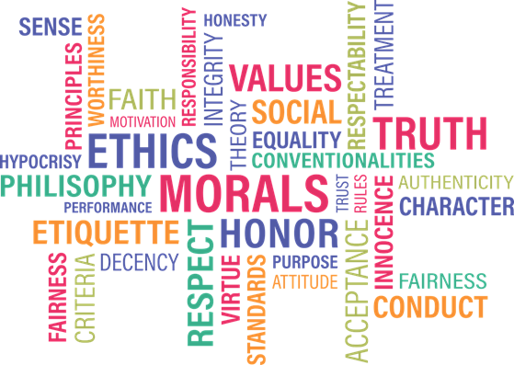
What are ethical principles?
Ethical principles are pieces of advice which can help us make a decision.
How we treat ourselves and each other is usually guided by the moral principles we adopt throughout life.
1.3 Ethical principles and their relevance to ICT and AI
Source: https://pixabay.com/de/vectors/gesch%c3%a4ft-idee-stil-konzept-tore-1753098/
This project has been funded with support from the European Commission under the Erasmus+ Programme.
This publication only reflects the views of the author, and the Commission cannot be held responsible for any
use which may be made of the information contained therein. (2020-1-DE02-KA226-VET-00813)

Slide 4
For example, these principles can be:
Fairness – treating everyone equally
Respect – acknowledging that people can decide on their own and respecting their right to do so
Benevolence – being kind and generous to others
1.3 Ethical principles and their relevance to ICT and AI
Source: https://pixabay.com/de/vectors/balance-ethik-werte-rechts-falsch-6097898/
This project has been funded with support from the European Commission under the Erasmus+ Programme.
This publication only reflects the views of the author, and the Commission cannot be held responsible for any
use which may be made of the information contained therein. (2020-1-DE02-KA226-VET-00813)

Slide 5
Why is AI ethics important?
AI is all around us. It helps us connect with others, cure diseases, etc.
Unfortunately it can also discriminate against us and violates some of our basic rights.
Because of its great impact on society, it’s essential to develop AI which will benefit us all.
1.3 Ethical principles and their relevance to ICT and AI
This project has been funded with support from the European Commission under the Erasmus+ Programme.
This publication only reflects the views of the author, and the Commission cannot be held responsible for any
use which may be made of the information contained therein. (2020-1-DE02-KA226-VET-00813)

Slide 6
We need to set guiding ethical principles to help us throughout the process of creating morally good AI.
In your opinion, what would be the most important principles for morally good AI?
Justice? Fairness? Transparency?
1.3 Ethical principles and their relevance to ICT and AI
Source: https://www.pexels.com/photo/ground-group-growth-hands-461049/
This project has been funded with support from the European Commission under the Erasmus+ Programme.
This publication only reflects the views of the author, and the Commission cannot be held responsible for any
use which may be made of the information contained therein. (2020-1-DE02-KA226-VET-00813)

Slide 7
Group activity
Talk to your peers and write down three ethical rules you think every AI should abide by. Present your results to the class once you have finished the assignment.
1.3 Ethical principles and their relevance to ICT and AI
Source: https://www.pexels.com/photo/group-of-people-sitting-on-chair-5212687/
This project has been funded with support from the European Commission under the Erasmus+ Programme.
This publication only reflects the views of the author, and the Commission cannot be held responsible for any
use which may be made of the information contained therein. (2020-1-DE02-KA226-VET-00813)

Slide 8
Group activity
For example:
1. AI should be impartial – its impact on individuals should be the same for all. It should not favour one group of people over another.
2. AI should ensure everyone leads a good life and help people improve their well-being.
3. AI should be transparent – easily understood, so everyone knows how it was made and how it makes decisions.
1.3 Ethical principles and their relevance to ICT and AI
This project has been funded with support from the European Commission under the Erasmus+ Programme.
This publication only reflects the views of the author, and the Commission cannot be held responsible for any
use which may be made of the information contained therein. (2020-1-DE02-KA226-VET-00813)

Slide 9
Questions or comments?
1.3 Ethical principles and their relevance to ICT and AI
Source: https://www.pexels.com/photo/robot-pointing-on-a-wall-8386440/
This project has been funded with support from the European Commission under the Erasmus+ Programme.
This publication only reflects the views of the author, and the Commission cannot be held responsible for any
use which may be made of the information contained therein. (2020-1-DE02-KA226-VET-00813)

Slide 10
Food for thought
What do you see as the most important ethical values?
If you were working in a company which creates AI, how would you transfer these values to AI?
1.3 Ethical principles and their relevance to ICT and AI
This project has been funded with support from the European Commission under the Erasmus+ Programme.
This publication only reflects the views of the author, and the Commission cannot be held responsible for any
use which may be made of the information contained therein. (2020-1-DE02-KA226-VET-00813)

Slide 11
Further reading
To introduce you to the field of ethics:
Ethics – a general introduction: https://www.bbc.co.uk/ethics/introduction/intro_1.shtml
Ethics in more detail: https://www.philosophybasics.com/branch_ethics.html
Basic ethical principles:
http://web.mnstate.edu/gracyk/courses/phil%20115/Four_Basic_principles.htm
To help you understand AI ethics and important ethical AI principles:
A guide to AI ethics: https://towardsdatascience.com/ethics-of-ai-a-comprehensive-primer-1bfd039124b0
Asilomar AI principles: https://futureoflife.org/ai-principles/
AI Google principles: https://ai.google/principles/
Microsoft AI principles: https://www.microsoft.com/en-us/ai/responsible-ai?activetab=pivot1%3aprimaryr6
1.3 Ethical principles and their relevance to ICT and AI
This project has been funded with support from the European Commission under the Erasmus+ Programme.
This publication only reflects the views of the author, and the Commission cannot be held responsible for any
use which may be made of the information contained therein. (2020-1-DE02-KA226-VET-00813)

Slide 12
Project website: www.ai-future-project.eu
Facebook page: facebook.com/artin-future

