Slide 1
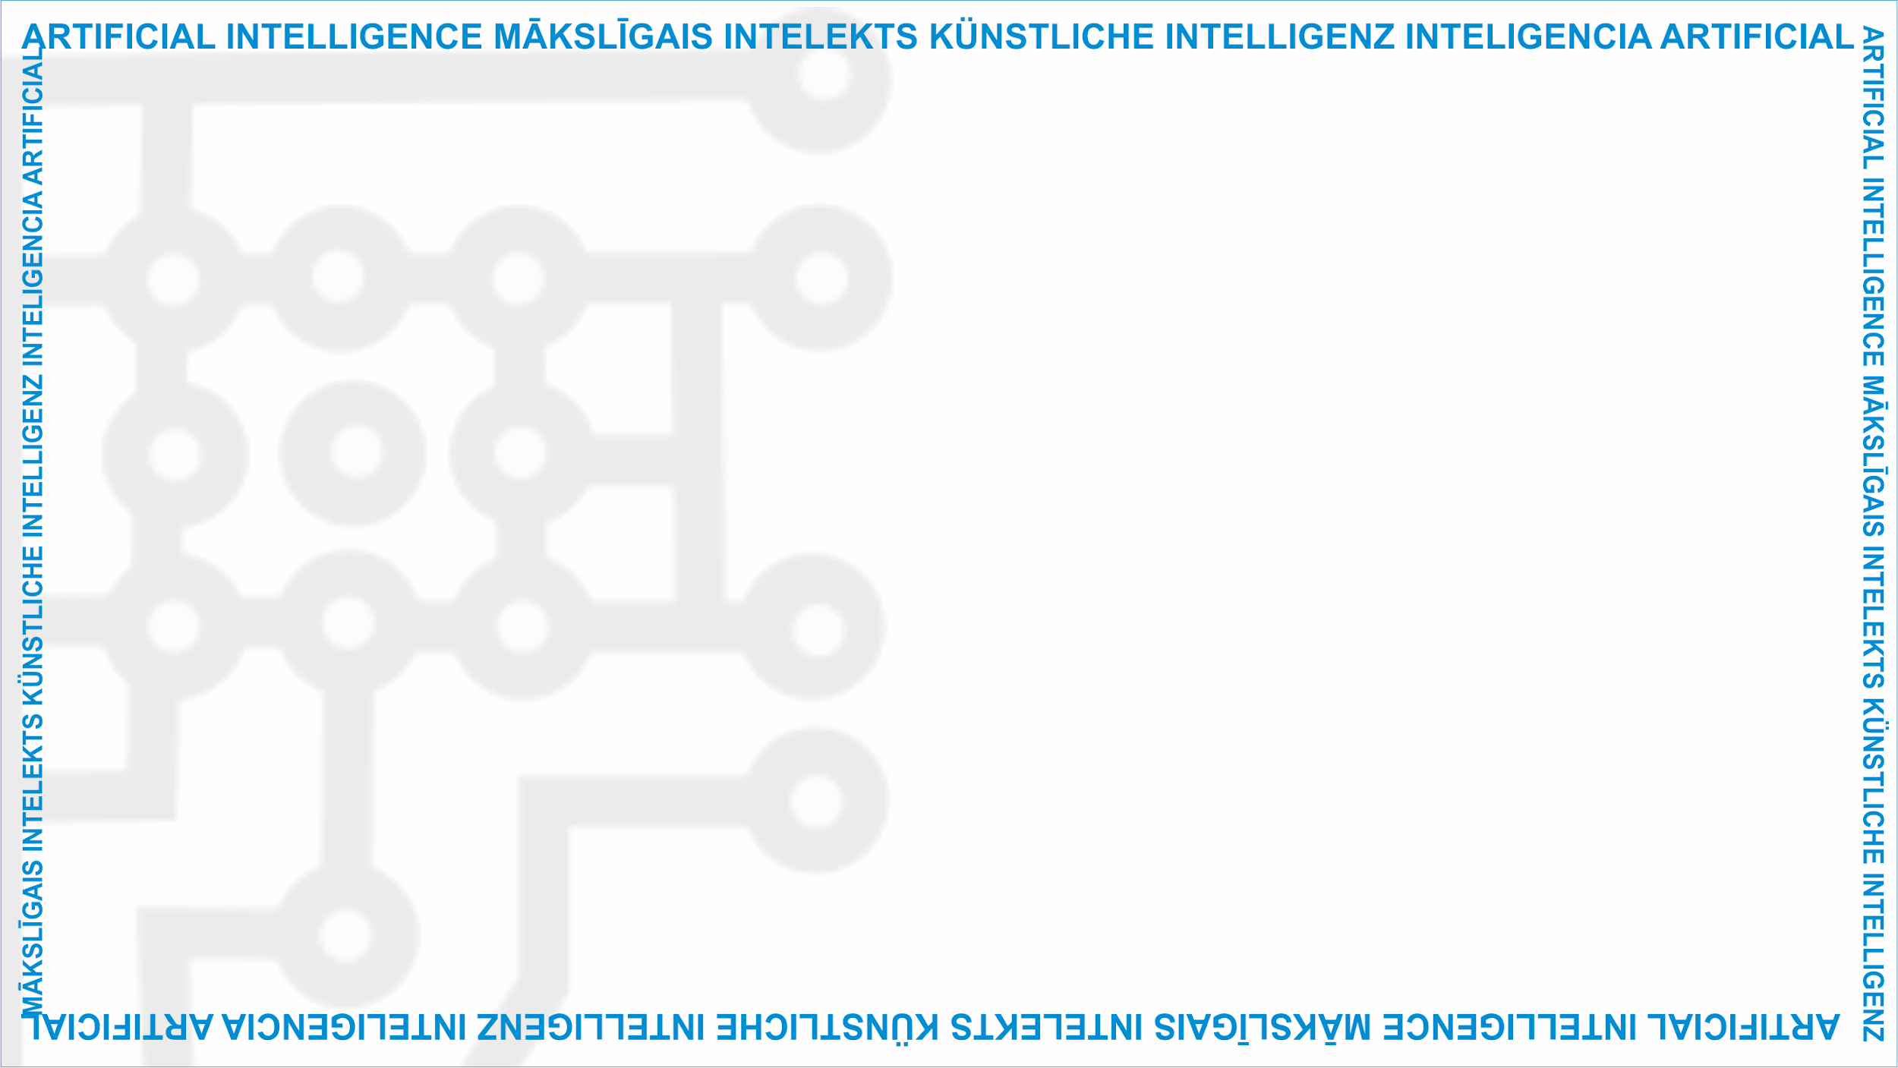
ArtIn Future – Ethics in Artificial Intelligence
Module: What is AI?
Unit: Introduction to artificial intelligence
Target learners: 9th-grade learners (14-15 years old)
Developed by:
BEST Institut für berufsbezogene Weiterbildung und Personaltraining GmbH

Slide 2
What is artificial intelligence?
Artificial intelligence (AI) is a non-human intelligence.
It’s a machine’s ability to think, learn, plan or make decisions in a way similar to humans.
Unit Lesson
1.1 Introduction to artificial intelligence
Source: https://www.pexels.com/photo/robot-s-hand-on-a-blue-background-8386437//
This project has been funded with support from the European Commission under the Erasmus+ Programme.
This publication only reflects the views of the author, and the Commission cannot be held responsible for any
use which may be made of the information contained therein. (2020-1-DE02-KA226-VET-00813)

Slide 3
What is AI?
Artificial intelligence can collect data, analyse it, learn from it, and make decisions based on the knowledge it has.
Unlike humans, who can only process small amounts of information, AI can work with a vast amount of information.
1.1 Introduction to artificial intelligence
Source: https://www.pexels.com/photo/green-and-yellow-printed-textile-330771/
This project has been funded with support from the European Commission under the Erasmus+ Programme.
This publication only reflects the views of the author, and the Commission cannot be held responsible for any
use which may be made of the information contained therein. (2020-1-DE02-KA226-VET-00813)

Slide 4
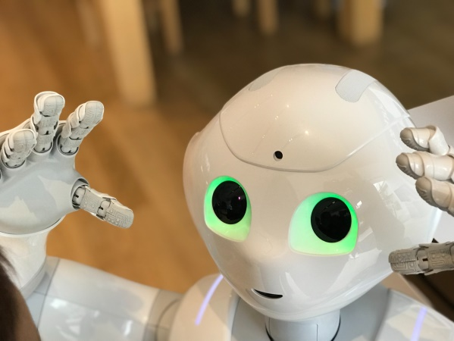
History of AI
The idea of artificial intelligence dates back to the 1950s, when Alan Turing, a famous British computer scientist, mentioned ‘thinking machines’ for the first time.
1.1 Introduction to artificial intelligence
Source: https://www.pexels.com/photo/close-up-shot-of-a-white-robot-6019019/
This project has been funded with support from the European Commission under the Erasmus+ Programme.
This publication only reflects the views of the author, and the Commission cannot be held responsible for any
use which may be made of the information contained therein. (2020-1-DE02-KA226-VET-00813)

Slide 5
History of AI
Based on Turing’s ideas, John McCarthy, Marvin Minsky, Nathaniel Rochester, and Claude Shannon coined the term ‘artificial intelligence’ in 1956.
That same year this group of American computer scientists founded AI as an academic discipline too.
1.1 Introduction to artificial intelligence
This project has been funded with support from the European Commission under the Erasmus+ Programme.
This publication only reflects the views of the author, and the Commission cannot be held responsible for any
use which may be made of the information contained therein. (2020-1-DE02-KA226-VET-00813)

Slide 6
AI today
Artificial intelligence has significantly progressed in the 21st century compared to its beginnings.
Nowadays, it is not only capable of collecting and processing a large amount of information and work autonomously, but it can also adapt its behaviour by independently analysing its previous actions.
1.1 Introduction to artificial intelligence
Source: https://pixabay.com/de/illustrations/fragezeichen-k%c3%bcnstliche-intelligenz-6786623/
This project has been funded with support from the European Commission under the Erasmus+ Programme.
This publication only reflects the views of the author, and the Commission cannot be held responsible for any
use which may be made of the information contained therein. (2020-1-DE02-KA226-VET-00813)

Slide 7
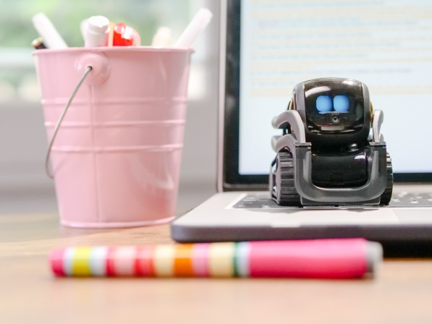
Types of AI
Based on the form it takes, there are two types of AI:
Software AI – virtual assistants, search engines, image analysis software or speech and language recognition systems.
‘Embodied’ AI – in robots, self-driving cars, drones or Internet of Things.
1.1 Introduction to artificial intelligence
Source: https://www.pexels.com/photo/miniature-toy-robot-on-top-of-laptop-s-keyboard-8566458/
This project has been funded with support from the European Commission under the Erasmus+ Programme.
This publication only reflects the views of the author, and the Commission cannot be held responsible for any
use which may be made of the information contained therein. (2020-1-DE02-KA226-VET-00813)

Slide 8
Types of AI
Based on its performance ability, there are:
Weak or artificial narrow intelligence (ANI)
Strong or artificial general intelligence (AGI)
Artificial superintelligence (ASI)
1.1 Introduction to artificial intelligence
Source: https://www.pexels.com/photo/person-pointing-numeric-print-1342460/
This project has been funded with support from the European Commission under the Erasmus+ Programme.
This publication only reflects the views of the author, and the Commission cannot be held responsible for any
use which may be made of the information contained therein. (2020-1-DE02-KA226-VET-00813)

Slide 9
Group activity
But what are ANI, AGI, and ASI? Divide into three teams to learn more about these types of AI. Each team should research one of these AIs. Present your research to the whole class once you have finished.
1.1 Introduction to artificial intelligence
Source: https://www.pexels.com/photo/group-of-people-sitting-on-chair-5212687/
This project has been funded with support from the European Commission under the Erasmus+ Programme.
This publication only reflects the views of the author, and the Commission cannot be held responsible for any
use which may be made of the information contained therein. (2020-1-DE02-KA226-VET-00813)

Slide 10
Questions or comments?
1.1 Introduction to artificial intelligence
Source: https://www.pexels.com/photo/robot-pointing-on-a-wall-8386440/
This project has been funded with support from the European Commission under the Erasmus+ Programme.
This publication only reflects the views of the author, and the Commission cannot be held responsible for any
use which may be made of the information contained therein. (2020-1-DE02-KA226-VET-00813)

Slide 11
Food for thought
How much did you know about AI before the class?
What are your thoughts on the future of AI?
Do you think we are capable of developing AI which is more powerful than human intelligence?
1.1 Introduction to artificial intelligence
This project has been funded with support from the European Commission under the Erasmus+ Programme.
This publication only reflects the views of the author, and the Commission cannot be held responsible for any
use which may be made of the information contained therein. (2020-1-DE02-KA226-VET-00813)

Slide 12
Further reading
To give you more information about AI:
AI in a nutshell: https://www.techopedia.com/definition/190/artificial-intelligence-ai
AI – definition and terminology:
https://towardsdatascience.com/artificial-intelligence-ai-terms-simply-explained-745c4734dc6c
Videos about AI:
Artificial intelligence in 5 minutes: https://www.youtube.com/watch?v=ad79nYk2keg
AI and its future: https://www.youtube.com/watch?v=SN2BZswEWUA
Unit Lesson
1.1 Ethical principles and their relevance to ICT and AI
This project has been funded with support from the European Commission under the Erasmus+ Programme.
This publication only reflects the views of the author, and the Commission cannot be held responsible for any
use which may be made of the information contained therein. (2020-1-DE02-KA226-VET-00813)

Slide 13
Project website: www.ai-future-project.eu
Facebook page: facebook.com/artin-future

