Slide 1
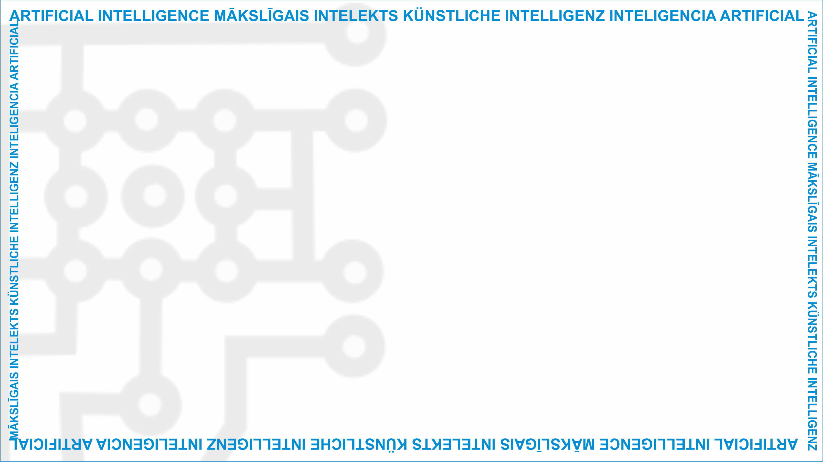
ArtIn Future – Ethik in der Künstlichen Intelligenz
Modul: Welche Auswirkungen hat KI?
Einheit: Ethische Kompetenzen und Einstellungen, um Menschen für das Leben und Arbeiten mit KI-Technologien vorzubereiten
Fünf-Punkte ethischer Leitfaden für eine nutzbringende KI
Zielgruppe: 9.-Klässler:innen (14-15 Jahre alt)
Entwickelt durch:
BEST Institut für berufsbezogene Weiterbildung und Personaltraining GmbH

Slide 2
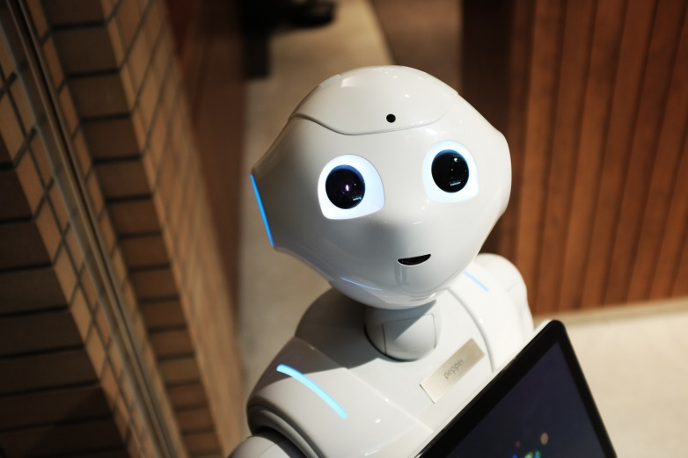
Aufwärmübung
Frage: Wie würdet ihr KI definieren?
Unterrichtseinheit
3.3 Ethische Fähigkeiten und Einstellungen, um die Menschen auf das Leben und Arbeiten mit KI-Technologien vorzubereiten
Quelle: https://www.pexels.com/photo/high-angle-photo-of-robot-2599244/
The European Commission'support for the production of this publication does not constitute an endorsement of the contents, which reflect the views only of the authors, and the Commission cannot be held responsible for any use which may be made of the information contained therein.( (2020-1-DE02-KA226-VET-008138)

Slide 3
5 Prinzipien für eine ethische KI:
Die menschliche Entwicklung sollte eine Grundlage für eine ethische KI sein. Deswegen sollte jede KI:
gut für die Menschheit und nachhaltig für den Planeten sein.
unsere Rechte schützen.
uns unsere eigenen Entscheidungen treffen lassen.
eine glückliche und gerechte Gesellschaft erhalten.
leicht verständlich und transparent sein.
3.3 Ethische Fähigkeiten und Einstellungen, um die Menschen auf das Leben und Arbeiten mit KI-Technologien vorzubereiten
The European Commission'support for the production of this publication does not constitute an endorsement of the contents, which reflect the views only of the authors, and the Commission cannot be held responsible for any use which may be made of the information contained therein.( (2020-1-DE02-KA226-VET-008138)

Slide 4
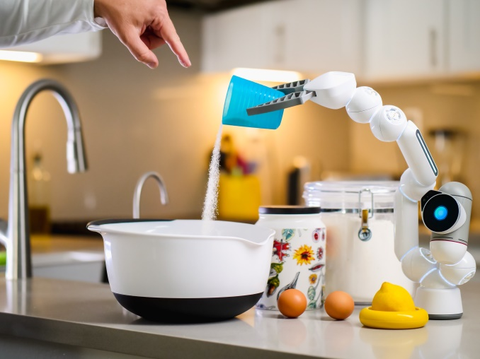
Let‘s see if AI passes our moral test!
3.3 Ethical skills and attitudes to prepare humans for life and work with AI technologies
Source: https://www.pexels.com/photo/dawn-man-woman-coffee-9028872/
This project has been funded with support from the European Commission under the Erasmus+ Programme.
This publication reflects the views only of the author, and the Commission cannot be held responsible for any
use which may be made of the information contained therein. (2020-1-DE02-KA226-VET-00813)

Slide 5
Group activity
Create teams and see if any of the following examples of AI pass the test:
Smart assistants
Navigation apps
Facial recognition systems
3.3 Ethical skills and attitudes to prepare humans for life and work with AI technologies
This project has been funded with support from the European Commission under the Erasmus+ Programme.
This publication reflects the views only of the author, and the Commission cannot be held responsible for any
use which may be made of the information contained therein. (2020-1-DE02-KA226-VET-00813)

Slide 6
What is a smart assistant?
A software installed in a smart device that can perform certain tasks, provide services, or answer questions.
Amazon‘s Alexa, Windows‘ Cortana, or iPhone‘s Siri are the most known examples.
3.3 Ethical skills and attitudes to prepare humans for life and work with AI technologies
Source: https://www.pexels.com/photo/wood-dawn-coffee-dark-4790268/
This project has been funded with support from the European Commission under the Erasmus+ Programme.
This publication reflects the views only of the author, and the Commission cannot be held responsible for any
use which may be made of the information contained therein. (2020-1-DE02-KA226-VET-00813)

Slide 7
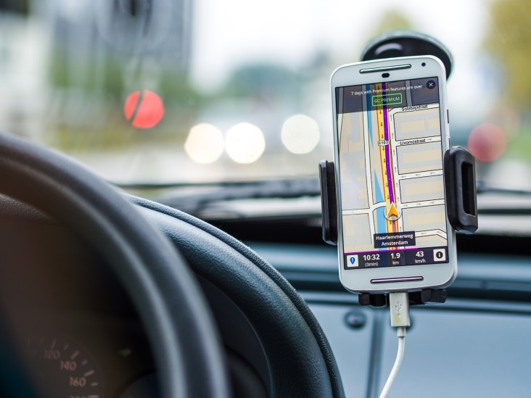
What is a navigation app?
AI-powered mobile or device applications that can take a person from point A to point B in real time. For example: Google Maps.
3.3 Ethical skills and attitudes to prepare humans for life and work with AI technologies
Source: https://www.pexels.com/photo/smartphone-car-technology-phone-33488/
This project has been funded with support from the European Commission under the Erasmus+ Programme.
This publication reflects the views only of the author, and the Commission cannot be held responsible for any
use which may be made of the information contained therein. (2020-1-DE02-KA226-VET-00813)

Slide 8
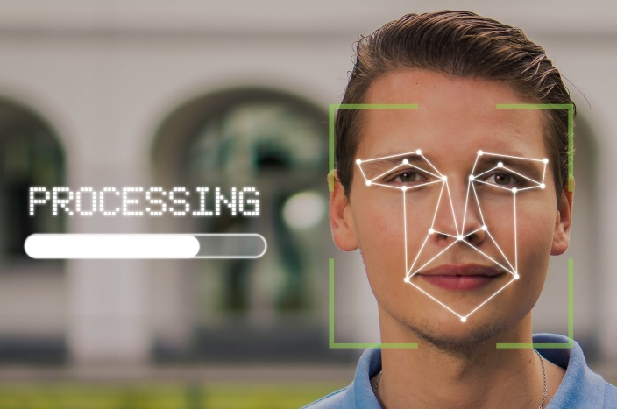
What is a facial recognition system?
A software that can quickly search through databases of faces and compare them to a face detected in an image or a video.
3.3 Ethical skills and attitudes to prepare humans for life and work with AI technologies
Source: https://pixabay.com/de/photos/mann-gesicht-gesichtserkennung-5946820/
This project has been funded with support from the European Commission under the Erasmus+ Programme.
This publication reflects the views only of the author, and the Commission cannot be held responsible for any
use which may be made of the information contained therein. (2020-1-DE02-KA226-VET-00813)

Slide 9
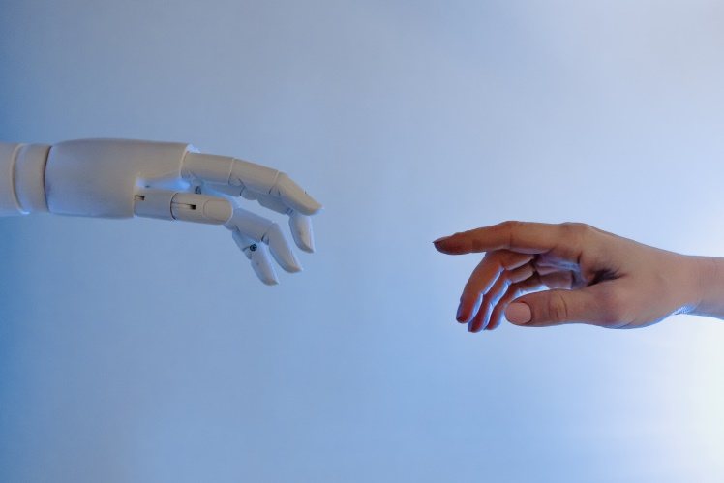
Questions or comments?
3.3 Ethical skills and attitudes to prepare humans for life and work with AI technologies
Source: https://www.pexels.com/photo/person-reaching-out-to-a-robot-8386434/
This project has been funded with support from the European Commission under the Erasmus+ Programme.
This publication reflects the views only of the author, and the Commission cannot be held responsible for any
use which may be made of the information contained therein. (2020-1-DE02-KA226-VET-00813)

Slide 10
Food for thought
How much did you learn after this lesson?
Do you think we are on our way of creating more ethical AI?
Have your ethical attitudes towards AI changed after this lesson?
3.3 Ethical skills and attitudes to prepare humans for life and work with AI technologies
This project has been funded with support from the European Commission under the Erasmus+ Programme.
This publication reflects the views only of the author, and the Commission cannot be held responsible for any
use which may be made of the information contained therein. (2020-1-DE02-KA226-VET-00813)

Slide 11
Weiterführende Literatur
Das sagen Expert:innen über Ethik in der KI:
Fünf Prinzipien für eine moralisch gute KI: https://hdsr.mitpress.mit.edu/pub/l0jsh9d1/release/7
EU-Richtlinien für eine vertrauenswürdige KI: https://digital-strategy.ec.europa.eu/en/library/ethics-guidelines-trustworthy-ai
Der ethische Standard für KI des IEEE: https://standards.ieee.org/content/dam/ieee-standards/standards/web/documents/other/ead1e_general_principles.pdf?utm_medium=undefined&utm_source=undefined&utm_campaign=undefined&utm_content=undefined&utm_term=undefined
3.3 Ethische Fähigkeiten und Einstellungen, um die Menschen auf das Leben und Arbeiten mit KI-Technologien vorzubereiten
The European Commission'support for the production of this publication does not constitute an endorsement of the contents, which reflect the views only of the authors, and the Commission cannot be held responsible for any use which may be made of the information contained therein.( (2020-1-DE02-KA226-VET-008138)

Slide 12
Projekt-Website: www.ai-future-project.eu
Facebook-Seite: facebook.com/artin-future

