Slide 1
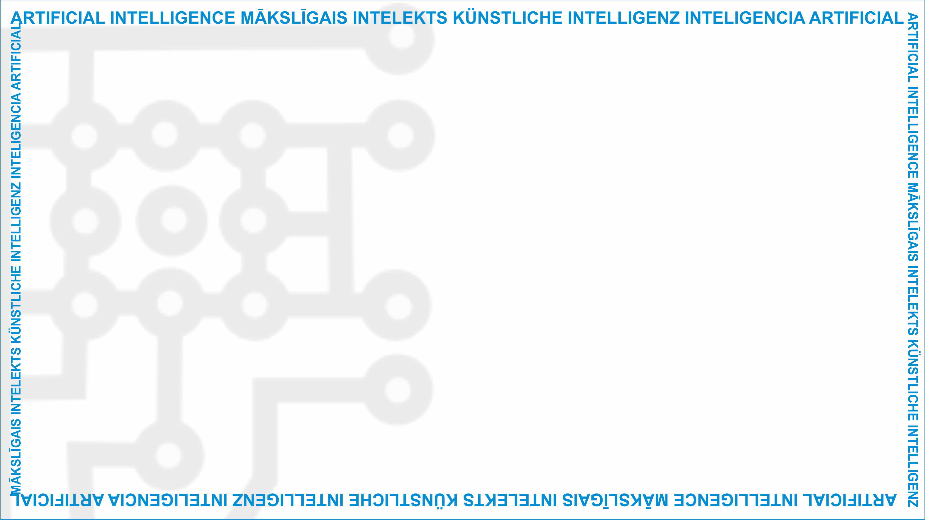
ArtIn Future – Ethik in der Künstlichen Intelligenz
Modul: Welche Auswirkungen hat KI?
Einheit: Die Folgen von KI für künftiges Arbeiten und Leben und die daraus folgenden ethischen Implikationen
Ethische Auswirkungen von KI auf die Arbeitswelt der Zukunft
Zielgruppe: 9.-Klässler:innen (14-15 Jahre alt)
Entwickelt durch:
BEST Institut für berufsbezogene Weiterbildung und Personaltraining GmbH

Slide 2
KI und die Arbeit
Nun, da wir wissen, wie sich KI auf unser Alltagsleben auswirkt, denken wir darüber nach, welche Folgen KI hat, wenn ihr erwachsen seid und anfangen werdet, zu arbeiten.
3.2 Die Auswirkungen von KI auf künftiges Leben und Arbeiten sowie dessen Bedeutung für die Ethik
Quelle: https://www.pexels.com/photo/group-of-people-watching-on-laptop-1595385/
The European Commission'support for the production of this publication does not constitute an endorsement of the contents, which reflect the views only of the authors, and the Commission cannot be held responsible for any use which may be made of the information contained therein.( (2020-1-DE02-KA226-VET-008138)

Slide 3
Arten von Arbeiten
Man unterscheidet üblicherweise zwischen Büroarbeit und Handwerksberufen.
Bei der Büroarbeit werden administrative und leitende Aufgaben und Arbeit am Schreibtisch ausgeführt. Eine Person mit einem Bürojob führt keine körperlichen Tätigkeiten aus.
3.2 Die Auswirkungen von KI auf künftiges Leben und Arbeiten sowie dessen Bedeutung für die Ethik
Quelle: https://www.pexels.com/photo/man-in-black-suit-working-7821702/
The European Commission'support for the production of this publication does not constitute an endorsement of the contents, which reflect the views only of the authors, and the Commission cannot be held responsible for any use which may be made of the information contained therein.( (2020-1-DE02-KA226-VET-008138)

Slide 4
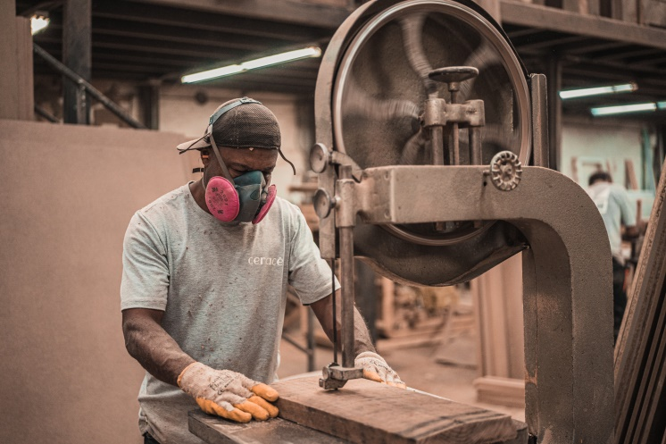
Arten von Arbeiten
Personen in Handwerksberufen üben körperliche Tätigkeiten aus und arbeiten auf Baustellen, in einer Fabrik und ähnlichem.
3.2 Die Auswirkungen von KI auf künftiges Leben und Arbeiten sowie dessen Bedeutung für die Ethik
Quelle: https://www.pexels.com/photo/man-working-on-wooden-plank-using-a-machine-3637833/
The European Commission'support for the production of this publication does not constitute an endorsement of the contents, which reflect the views only of the authors, and the Commission cannot be held responsible for any use which may be made of the information contained therein.( (2020-1-DE02-KA226-VET-008138)

Slide 5
Fishbowl discussion
To learn about the effect of the entire workforce, we will have a fishbowl discussion.
Form two teams. One team will share their thoughts of how AI will affect white-collars, while the other team should discuss the effects of AI on blue-collars.
3.2 The effects of AI on future work and life and its ethical implications
This project has been funded with support from the European Commission under the Erasmus+ Programme.
This publication reflects the views only of the author, and the Commission cannot be held responsible for any
use which may be made of the information contained therein. (2020-1-DE02-KA226-VET-00813)

Slide 6
Fishbowl discussion rules
Form a circle of chairs. This will be our fishbowl.
Surround that circle with more chairs so that the other group can see what is happening in the fishbowl.
Each group will have 5 minutes to present their opinions.
When you hear the word ‘Switch’, the team that has been listening will take the role of speaker.
Overall, the discussion should last for about an hour.
3.2 The effects of AI on future work and life and its ethical implications
This project has been funded with support from the European Commission under the Erasmus+ Programme.
This publication reflects the views only of the author, and the Commission cannot be held responsible for any
use which may be made of the information contained therein. (2020-1-DE02-KA226-VET-00813)
Notes:
NB: adapt the duration to the number of groups you really have in your class for this activity

Slide 7
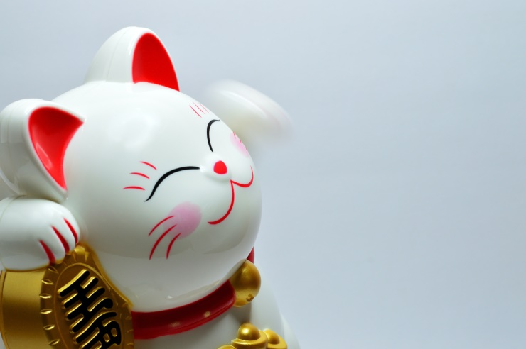
Fishbowl discussion rules
You have 30 minutes to prepare for the discussion. Good luck!
3.2 The effects of AI on future work and life and its ethical implications
Source: https://www.pexels.com/search/good%20luck/
This project has been funded with support from the European Commission under the Erasmus+ Programme.
This publication reflects the views only of the author, and the Commission cannot be held responsible for any
use which may be made of the information contained therein. (2020-1-DE02-KA226-VET-00813)

Slide 8
Food for thought
Did you enjoy the discussion?
What did you learn from your teammates?
3.2 The effects of AI on future work and life and its ethical implications
This project has been funded with support from the European Commission under the Erasmus+ Programme.
This publication reflects the views only of the author, and the Commission cannot be held responsible for any
use which may be made of the information contained therein. (2020-1-DE02-KA226-VET-00813)

Slide 9
Projekt-Website: www.ai-future-project.eu
Facebook-Seite: facebook.com/artin-future

